Slide 1
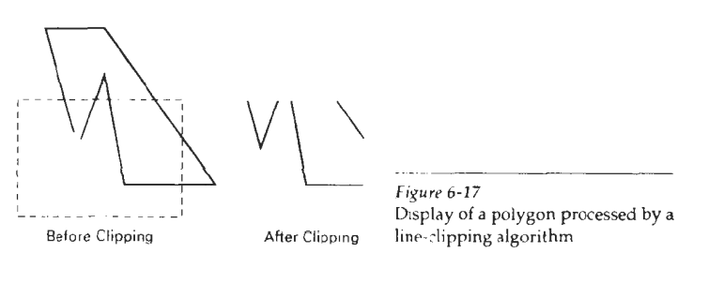
POLYGON CLIPPING:
To clip polygons, we need to modify the line-clipping procedures discussed in the previous section. A polygon boundary processed with a line clipper may be displayed as a series of unconnected line segments (Fig. 6-17), depending on the orientation of the polygon to the clipping window. What we really want to display is a bounded area after clipping, as in Fig. 6-18. For polygon clipping, we require an algorithm that will generate one or more closed areas that are then scan converted for the appropriate area fill. The output of a polygon clipper should be a sequence of vertices that defines the clipped polygon boundaries.

Slide 2
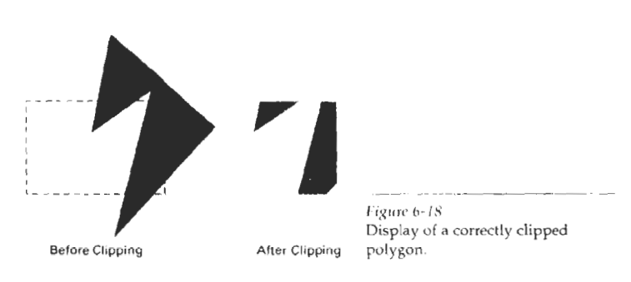
Sutherland-Hodgeman Polygon Clipping:
We can correctly clip a polygon by processing the polygon boundary as a whole against each window edge. This could be accomplished by processing all polygon vertices against each clip rectangle boundary in turn. Beginning with the initial set of polygon vertices, we could first clip the polygon against the left rectangle boundary to produce a new sequence of vertices. The new set of vertices could then be successively passed to a right boundary clipper, a bottom boundary clipper, and a top boundary clipper, as in Fig. 6-19. At each step, a new sequence of output vertices is generated and passed to the next window boundary clipper.

Slide 3
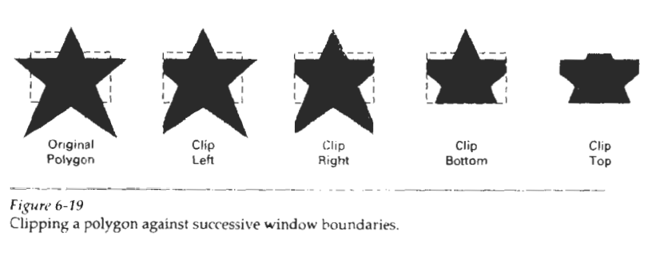
There are four possible cases when processing vertices in sequence around the perimeter of a polygon. As each pair of adjacent polygon vertices is passed to a window boundary clipper, we make the following tests:
If the first vertex is outside the window boundary and the second vertex is inside, both the intersection point of the polygon edge with the window boundary and the second vertex are added to the output vertex list.
If both input vertices are inside the window boundary, only the second vertex is added to the output vertex list.

Slide 4
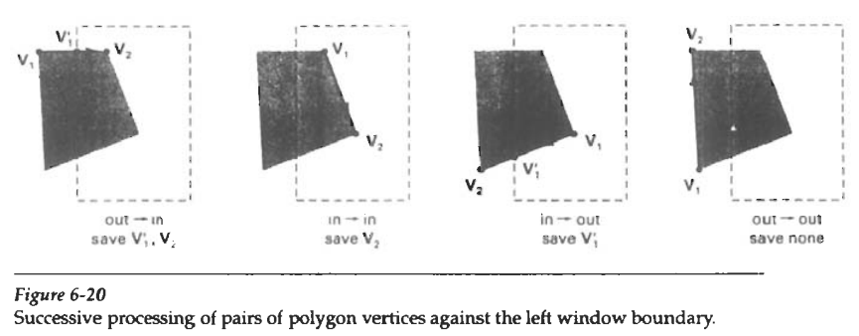
(3) If the first vertex is inside the window boundary and the second vertex is outside, only the edge intersection with the window boundary is added to the output vertex list.
(4) If both input vertices are outside the window boundary, nothing is added to the output list.
These four cases are illustrated in Fig. 6-20 for successive pairs of polygon vertices. Once all vertices have been processed for one clip window boundary, the output list of vertices is clipped against the next window boundary.

Slide 5
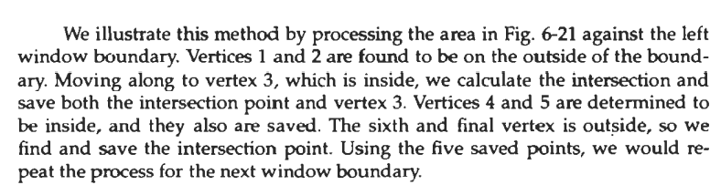
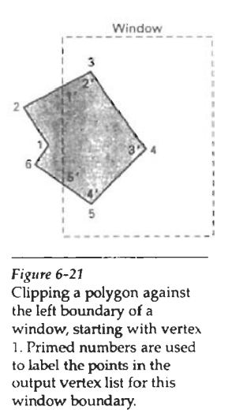

Slide 6
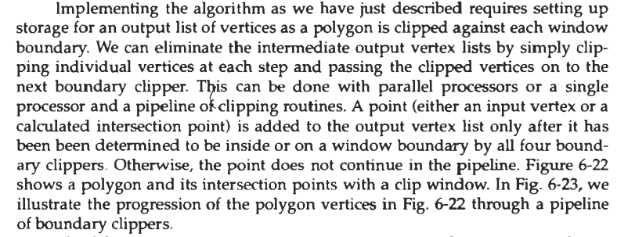

Slide 7
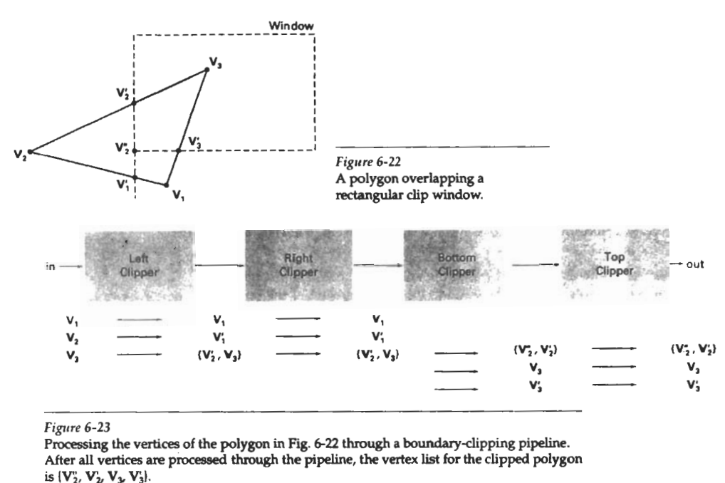

Slide 8
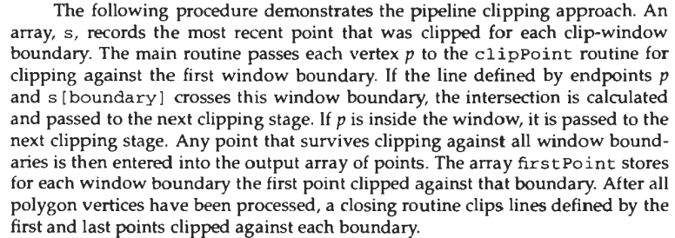

Slide 9
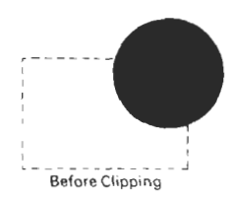
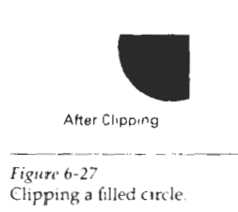
Curve Clipping:
Areas with curved boundaries can be clipped with methods similar to those discussed in the previous sections. Curve-clipping procedures will involve nonlinear equations, however, and this requires more processing than for objects with linear boundaries. The bounding rectangle for a circle or other curved object can be used first to test for overlap with a rectangular clip window. If the bounding rectangle for the object is completely inside the window, we save the object. If the rectangle is determined to be completely outside the window, we discard the object. In either case, there is no further computation necessary. But if the bounding rectangle test fails, we can look for other computation-saving approaches.

Slide 10
For a circle, we can use the coordinate extents of individual quadrants and then octants for preliminary testing before calculating curve-window intersections. For an ellipse, we can test the coordinate extents of individual quadrants. Figure 6-27 illustrates circle clipping against a rectangular window. Similar procedures can be applied when clipping a curved object against a general polygon clip region.
On the first pass, we can clip the bounding rectangle of the object against the bounding rectangle of the clip region. If the two regions overlap, we will need to solve the simultaneous line-curve equations to obtain the clipping intersection points.

Slide 11
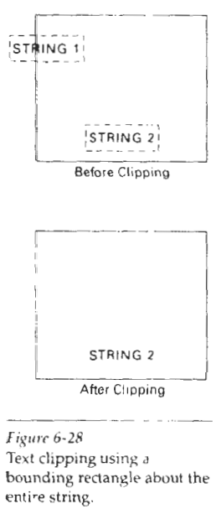
TEXT CLIPPING:
There are several techniques that can be used to provide text clipping in a graphics package. The clipping technique used will depend on the methods used to generate characters and the requirements of a particular application. The simplest method for processing character strings relative to a window boundary is to use the all-or-none string-clipping strategy shown in Fig. 6-28. If all of the string is inside a clip window, we keep it. Otherwise, the string is discarded. This procedure is implemented by considering a bounding rectangle around the text pattern. The boundary positions of the rectangle are then compared to the window boundaries, and the string is rejected if there is any overlap. This method produces the fastest text clipping.

Slide 12
An alternative to rejecting an entire character string that overlaps a window boundary is to use the all-or-none character-clipping strategy. Here we discard only those characters that are not completely inside the window (Fig. 6-29). In this case, the boundary limits of individual characters are compared to the window. Any character that either overlaps or is outside a window boundary is clipped.
A final method for handling text clipping is to clip the components of individual characters. We now treat characters in much the same way that we treated lines. If an individual character overlaps a clip window boundary, we clip off the parts of the character that are outside the window (Fig. 6-30). Outline character fonts formed with line segments can be processed in this way using a line clipping algorithm. Characters defined with bit maps would be clipped by comparing the relative position of the individual pixels in the character grid patterns to the clipping boundaries.

Slide 13
